Slide 1
Quantum Mechanics

Slide 2
Introduction
There are a few phenomenon which the classical mechanics failed to explain.
Stability of an atom
Spectral series of Hydrogen atom
Black body radiation
Max Planck in 1900 at a meeting of German Physical Society read his paper “On the theory of the Energy distribution law of the Normal Spectrum”. This was the start of the revolution of Physics i.e. the start of Quantum Mechanics.

Slide 3
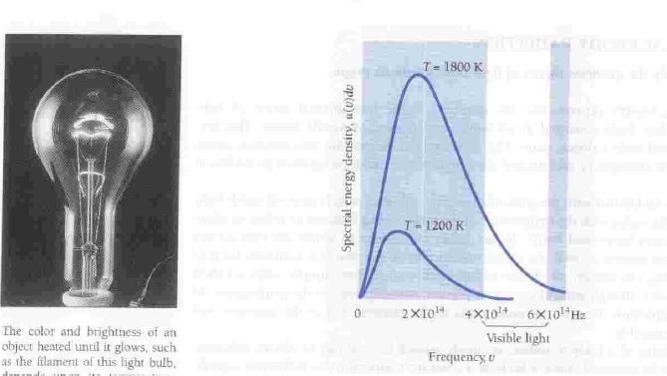

Slide 4
Quantum Mechanics
It is a generalization of Classical Physics that includes classical laws as special cases.
Quantum Physics extends that range to the region of small dimensions.
Just as ‘c’ the velocity of light signifies universal constant, the Planck's constant characterizes Quantum Physics.
h= 6.65×10⁻²⁷ erg.sec
h = 6.625×10⁻³⁴ Joule.sec

Slide 5
Quantum Mechanics
It is able to explain
Photo electric effect
Black body radiation
Compton effect
Emission of line spectra
The most outstanding development in modern science was the conception of Quantum Mechanics in 1925. This new approach was highly successful in explaining about the behavior of atoms, molecules and nuclei.

Slide 6
Photo Electric Effect
The emission of electrons from a metal plate when illuminated by light or any other radiation of any wavelength or frequency (suitable) is called photoelectric effect. The emitted electrons are called ‘photo electrons’.
Light
Evacuated Quartz
tube
Metal plate
Collecting
_
+
plate
V
^^^^^^^^
A

Slide 7

Quantum Physics: the “quantum” comes from quantization: we need to understand the origin of this.
The Photoelectric Effect
electrons
Electron detector
metal
light

Slide 8
Photo Electric Effect
Experimental findings of the photoelectric effect
There is no time lag between the arrival of light at the metal surface and the emission of photoelectrons.
When the voltage is increased to a certain value say V_{o}, the photocurrent reduces to zero.
Increase in intensity increase the number of the photoelectrons but the electron energy remains the same.
3I
2I
Photo Current
I
V_{o}
Voltage

Slide 9
Photo Electric Effect
4. Increase in frequency of light increases the energy of the electrons. At frequencies below a certain critical frequency (characteristics of each particular metal), no electron is emitted.
Photo Current
v₃
v₁
v₂ Voltage

Slide 10
Einstein’s Photo Electric Explanation
The energy of a incident photon is utilized in two ways
A part of energy is used to free the electron from the atom known as photoelectric workfunction (W_{o}).
Other part is used in providing kinetic energy to the emitted
electron .
⎛
1
⎞
⎜ ₂
mv
2
⎟
⎝
⎠
hν = W + ¹ mv²
o
2
This is called Einstein’s photoelectric equation.

Slide 11
hν = W_{o} + KE_{max} hν = hν _{o} + KE_{max} KE_{max} = h(ν −ν _{o} )
If ν <ν _{o} , no photoelectric effect
₌ hc
W = hν
o
o
λ
o
_{λ =} hc ₌ 12400
o
A
W W (eV )
o
o
o

Slide 12
If V_{o} is the stopping potential, then
KE_{max} = h(ν −ν _{o} )
eV_{o} = hν − hν _{o}
hν hν
V =
−
o
o
e e
It is in form of y = mx + c . The graph with V_{o} on y-axis
and ν
on x-axis will be a straight line with slope h e

Slide 13
Photons
Einstein postulated the existence of a particle called a photon, to explain detailed results of photoelectric experiment.
E = hν = ^{hc}
p
λ
Photon has zero rest mass, travels at speed of light
Explains “instantaneous” emission of electrons in photoelectric effect, frequency dependence.

Slide 14




Compton Effect
When a monochromatic beam of X-rays is scattered from a material then both the wavelength of primary radiation (unmodified radiation) and the radiation of higher wavelength (modified radiation) are found to be present in the scattered radiation. Presence of modified radiation in scattered X-rays is
called Compton effect.
E' = hν '
^{hν '} sin θ
scattered photon
c
incident photon
E = hν
θ
φ
mv cosφ
v
h
c
hν c
^{ν'} cosθ
electron
p =
mv sin φ
recoiled electron

Slide 15
Compton effect can’t observed in Visible Light
h
Δλ =
(1− cosθ )
m_{o}c
Δλ is maximum when (1- cosθ) is maximum i.e. 2.
Δλ_{max} =
0.05 Å
So Compton effect can be observed only for radiation having wavelength of few Å.
For λ = 1Å For λ = 5000Å
~ 1%
Δλ ~ 0.001% (undetectable)
Δλ

Slide 16


Pair Production
When a photon (electromagnetic energy) of sufficient energy passes near the field of nucleus, it materializes into an electron and positron. This phenomenon is known as pair
production.
_{e}−
Photon
_{e}+
Nucleus (+ve)
In this process charge, energy and momentum remains conserved prior and after the production of pair.

Slide 17
The rest mass energy of an electron or positron is 0.51 MeV (according to E = mc²).
The minimum energy required for pair production is 1.02 MeV.
Any additional photon energy becomes the kinetic energy of the electron and positron.
The corresponding maximum photon wavelength is 1.2 pm. Electromagnetic waves with such wavelengths are called gamma rays (γ ).

Slide 18
Pair Annihilation
When an electron and positron interact with each other due to their opposite charge, both the particle can annihilate converting their mass into electromagnetic energy in the form of two γ - rays photon.
e⁻ + e⁺ → γ + γ
Charge, energy and momentum are again conversed. Two
- photons are produced (each of energy 0.51 MeV plus half the K.E. of the particles) to conserve the momentum.
γ

Slide 19
Wave Particle Duality
Light can exhibit both kind of nature of waves and particles so the light shows wave-particle dual nature.
In some cases like interference, diffraction and polarization it behaves as wave while in other cases like photoelectric and compton effect it behaves as particles (photon).

Slide 20


Electrons
Interference: Wave-like behavior!!

Slide 21
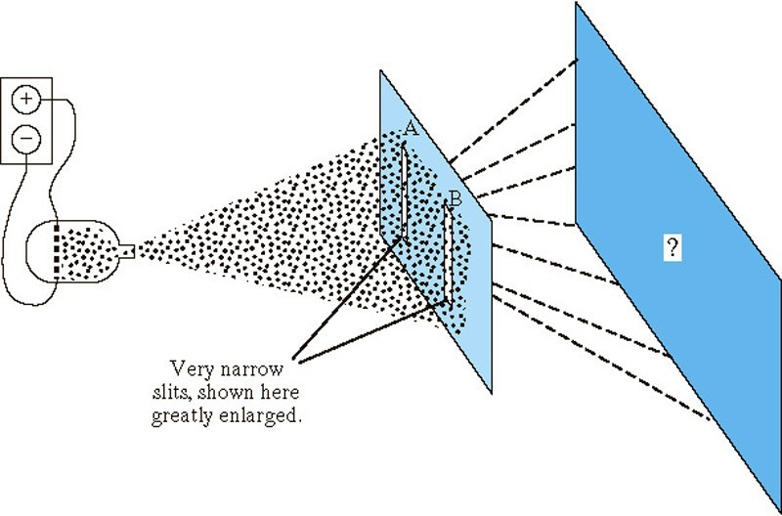
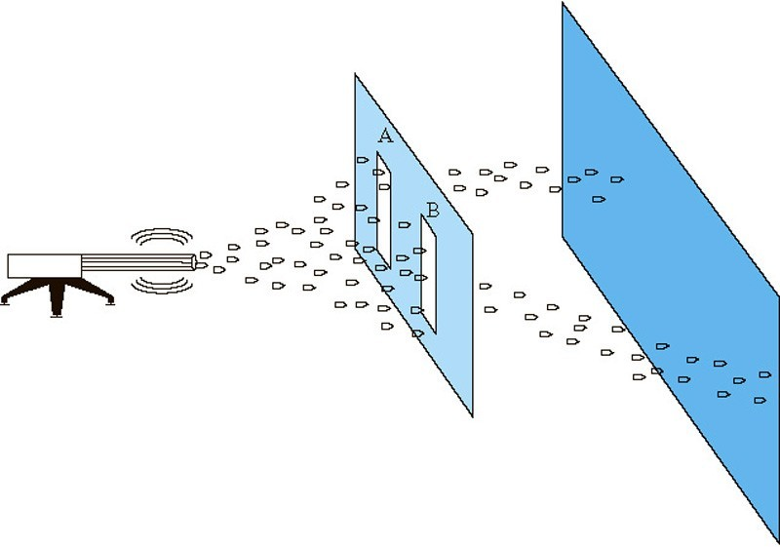
De Broglie, a Ph.D. student at the University of Paris in 1923, felt that if radiation exhibits wave-particle duality, matter should have a dual nature too!!!!!
This was confirmed using a double-slit experiment with particles of matter, such as electrons.

Slide 22

http://www.colorado.edu/physics/2000/index.pl

Slide 23
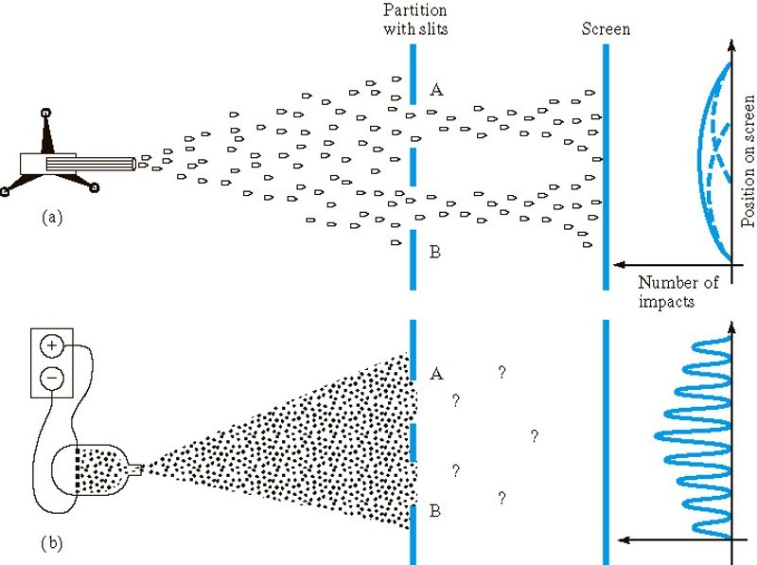

Slide 24
sand
electrons

Slide 25
sand
electrons

Slide 26
sand
electrons
Two overlapping piles of sand
Not just two overlapping “piles” of electrons

Slide 27
sand
electrons
Two overlapping piles of sand
Interference pattern

Slide 28
The Strange World of Quantum Physics
Photons (particles!)

Slide 29
One Photon
The Strange World of Quantum Physics
Where does it hit the screen??
Let’s watch one at a time…

Slide 30


Screen

Slide 31


Screen
Given ONE photon, we cannot predict exactly where it will hit.
We can only predict the PROBABILITY that it will hit a certain place on the screen: i.e., we can predict the pattern that many photons will make!!

Slide 32
De Broglie Waves
Not only the light but every materialistic particle such as electron, proton or even the heavier object exhibits wave- particle dual nature.
De-Broglie proposed that a moving particle, whatever its nature, has waves associated with it. These waves are called “matter waves”.
Energy of a photon is
E = hν
For a particle, say photon of mass, m
E = mc²

Slide 33
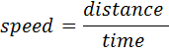
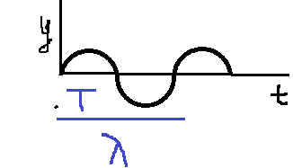
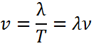
mc² = hv
mc² = ^{hc}
λ
λ = ^{h}
mc
Suppose a particle of mass, m is moving with velocity, v then the wavelength associated with it can be given by
λ = ^{h} or λ = ^{h}
mv p
(i) If v = 0 ⇒ λ = ∞
means that waves are associated with
moving material particles only.
(ii) De-Broglie wave does not depend on whether the moving particle is charged or uncharged. It means matter waves are not electromagnetic in nature.

Slide 34
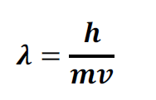
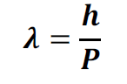
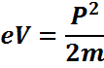
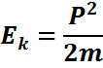
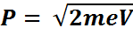
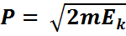
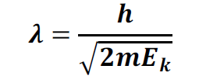
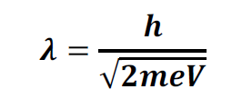
E_{k} Kinetic Energy, v – velocity of particle, e- Charge of electron
V – voltage , m - rest mass of particle , p – momentum of particle

Slide 35
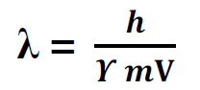
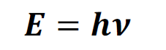
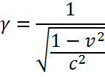
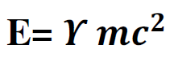
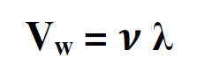
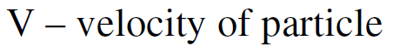
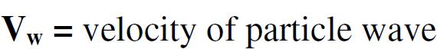
Wave particle Duality – wave group
Total energy of a particle

Slide 36
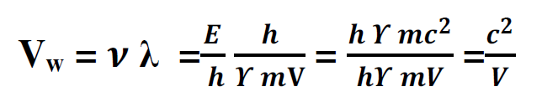
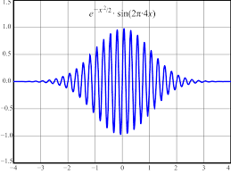

Slide 37
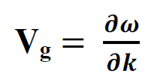
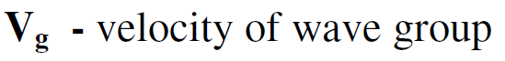
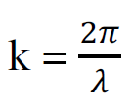
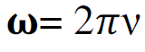
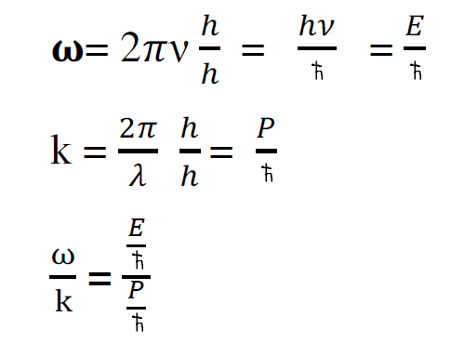
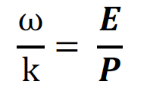

Slide 38
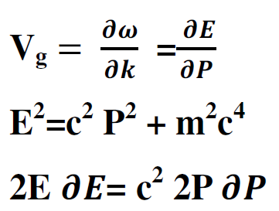
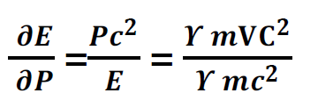
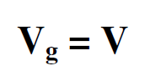

Slide 39
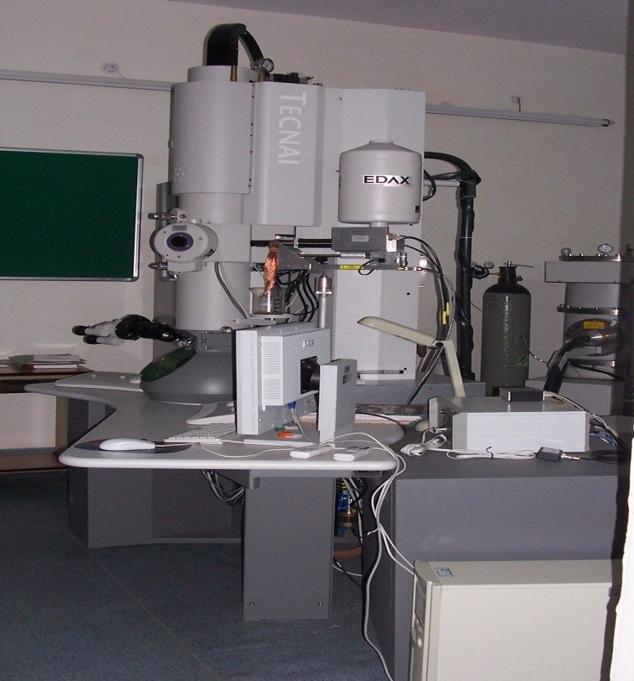
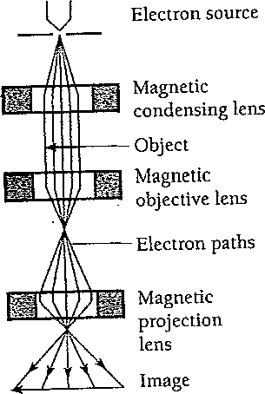
Electron Microscope: Instrumental Application of Matter Waves

Slide 40
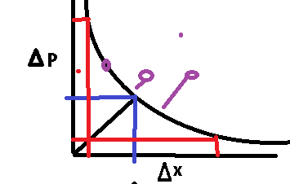
Heisenberg Uncertainty Principle
It states that only one of the “position” or “momentum” can be measured accurately at a single moment within the instrumental limit.
or
It is impossible to measure both the position and momentum simultaneously with unlimited accuracy.
Δx →
Δp_{x} →
uncertainty in position uncertainty in momentum
The product of Δx & Δp of an object is greate than or equal to
x

Slide 41
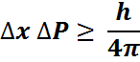
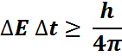
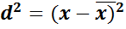
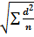
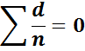
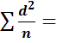
x | d = x -
11 | 1 | 1
10.5 | 0.5 | 0.25
9 | -1 | 1
9.5 | -0.5 | 0.25
 |  | 0.625
=
standard deviation

Slide 42
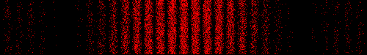
Radiation: waves or particles?
Radiation is made up of particles called photons Evidence of the wave nature from interference
Essentially, wave/particle duality employs the notion that an entity simultaneously possesses localized (particle) and distributed (wave) properties.
Close inspection shows that an interference pattern is formed by individual photons hitting all over a screen!!!
Interference → light were made up of waves. Pattern "speckled“ → individual particle impacts

Slide 43
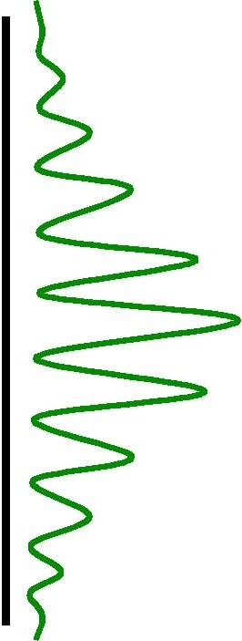
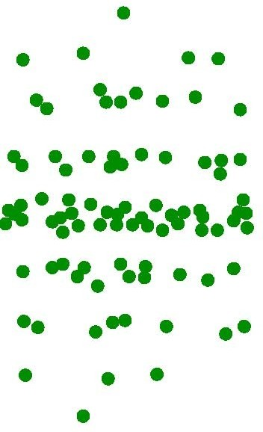

Two-slit Interference Experiment
Slit
1 meter
Laser Source
Slit
Detector
Rate of photon arrival = 2 x 10⁶/sec
Time lag = 0.5 x 10⁻⁶ sec
Spatial separation between photons = 0.5 x 10⁻⁶ c = 150 m

Slide 44
Double slit experiment – QM interpretation
–
–
–
patterns on screen are result of distribution of photons no way of anticipating where particular photon will strike
impossible to tell which path photon took – cannot assign specific trajectory to photon
cannot suppose that half went through one slit and half through other
can only predict how photons will be distributed on screen (or over detector(s))
interference and diffraction are statistical phenomena associated with probability that, in a given experimental setup, a photon will strike a certain point
high probability ⇒ bright fringes low probability ⇒ dark fringes
–
–
–
–
–

Slide 45
Double slit expt. -- wave vs quantum
wave theory quantum theory
•
pattern of fringes:
Intensity bands due to variations in square of amplitude, A², of resultant wave on each point on screen
role of the slits:
to provide two coherent sources of the secondary waves that interfere on the screen
pattern of fringes:
Intensity bands due to variations in probability, P, of a photon striking points on screen
role of the slits:
to present two potential routes by which photon can pass from source to screen
•

Slide 46
Wave function
The quantity with which Quantum Mechanics is concerned is the wave function of a body.
Wave function, ψ is a quantity associated with a moving particle. It is a complex quantity.
|Ψ|² is proportional to the probability of finding a particle at a particular point at a particular time. It is the probability density.
|ψ |² =ψ *ψ
ψ is the probability amplitude.
Thus if
ψ = A + iB ψ * = A − iB
then
⇒|ψ |² =ψ *ψ = A² − i² B² = A² + B²

Slide 47
Normalization
|Ψ|² is the probability density.
The probability of finding the particle within an element of volume dτ
|ψ |² dτ
Since the particle is definitely be somewhere, so
∞
∫|ψ |² dτ = 1
∴
Normalization
−∞
A wave function that obeys this equation is said to be normalized.

Slide 48
Properties of wave function
It must be finite everywhere.
If ψ is infinite for a particular point, it mean an infinite large probability of finding the particles at that point. This would violates the uncertainty principle.
It must be single valued.
If ψ has more than one value at any point, it mean more than one value of probability of finding the particle at that point which is obviously ridiculous.
3. It must be continuous and have a continuous first derivative everywhere.
∂ψ ∂ψ ∂ψ
must be continuous
∂x , ∂y , ∂z
4. It must be normalizable.

Slide 49
Linearity and Superposition
If ψ₁ and ψ₂ are two solutions of any Schrodinger equation of a system, then linear combination of ψ₁ and ψ₂ will also be a solution
of the equation.. _{ψ = a ψ}
a ψ
is also a solution
1 1
2 2
Here
a₁ & a₂
are constants
Above equation suggests:
The linear property of Schrodinger equation
ψ₁ and ψ₂ follow the superposition principle

Slide 50
Not only can these atom only EMIT photons of a certain frequency, but they can only ABSORB light of a certain frequency.
Energy
E5
E4
E3
E2
Photon
E1

Slide 51
Energy
After Planck: the particle could have only specific, quantized energies
Vibrating particle

Slide 52
Energy
This means that if a particle is in some energy state, if it is to give up energy in the form of light, it has to give up a definite amount
E1
Light with energy equal to E₁ - E₂= hf
E2
Vibrating particle
Same diagram as last slide except “blown up” to see the spacing better.

Slide 53
ψ → ψ ₁ +ψ ₂
If P₁ is the probability density corresponding to ψ₁ and P₂ is the probability density corresponding to ψ₂
Then due to superposition principle
Total probability will be
P =|ψ |² =|ψ +ψ
1 2
|2
= (ψ ₁ +ψ ₂ ) (ψ +ψ )
*
1 2
= (ψ * +ψ * )(ψ +ψ )
1 2
+ψ *ψ +ψ *ψ
1
2
=ψ *ψ
+ψ *ψ
1 1 2 2
1 2
2 1
P = P + P +ψ *ψ
1 2 1 2
+ψ *ψ
P ≠ P₁ + P₂
Probability density can’t be added linearly
2 1

Slide 54

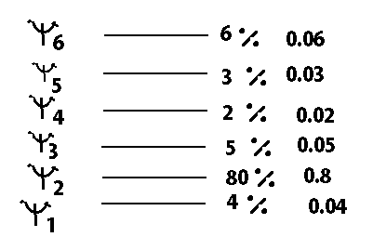
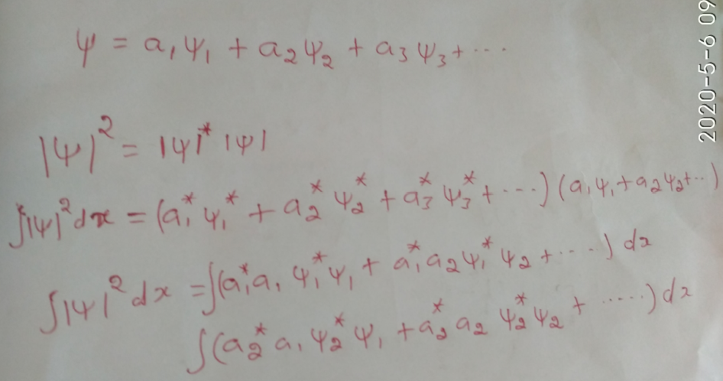

Slide 55
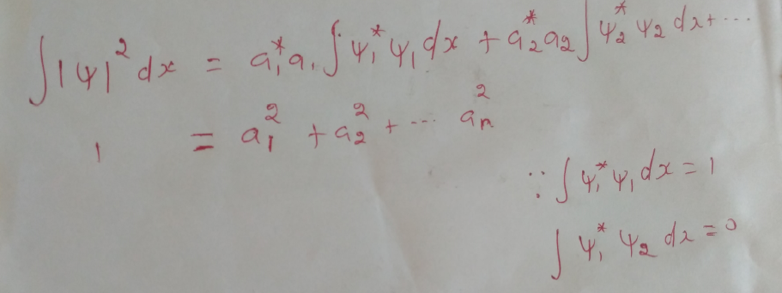
∞
∫ x |ψ |² dx
= 1
−∞

Slide 56
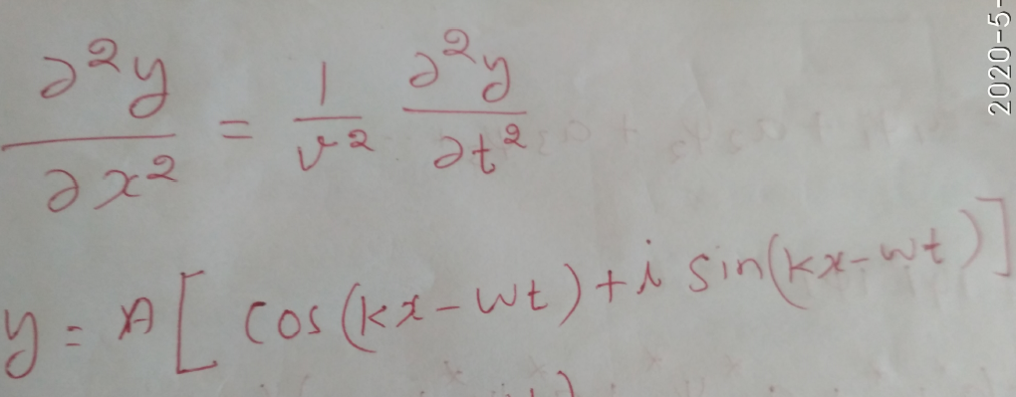
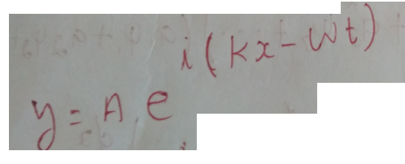

Slide 57


Slide 58


Slide 59


Slide 60


Slide 61


Slide 62


Slide 63


Slide 64


Slide 65
Expectation values
Expectation value of any quantity which is a function of ‘x’ ,say f(x)
is given by
< f (x) > = ∫ f (x) |ψ |² dx
−∞
∞
for normalized ψ
Thus expectation value for position ‘x’ is
∞
< x > = ∫ x |ψ |² dx
−∞
Expectation value is the value of ‘x’ we would obtain if we measured the positions of a large number of particles described by the same function at some instant ‘t’ and then averaged the results.

